Slide 1
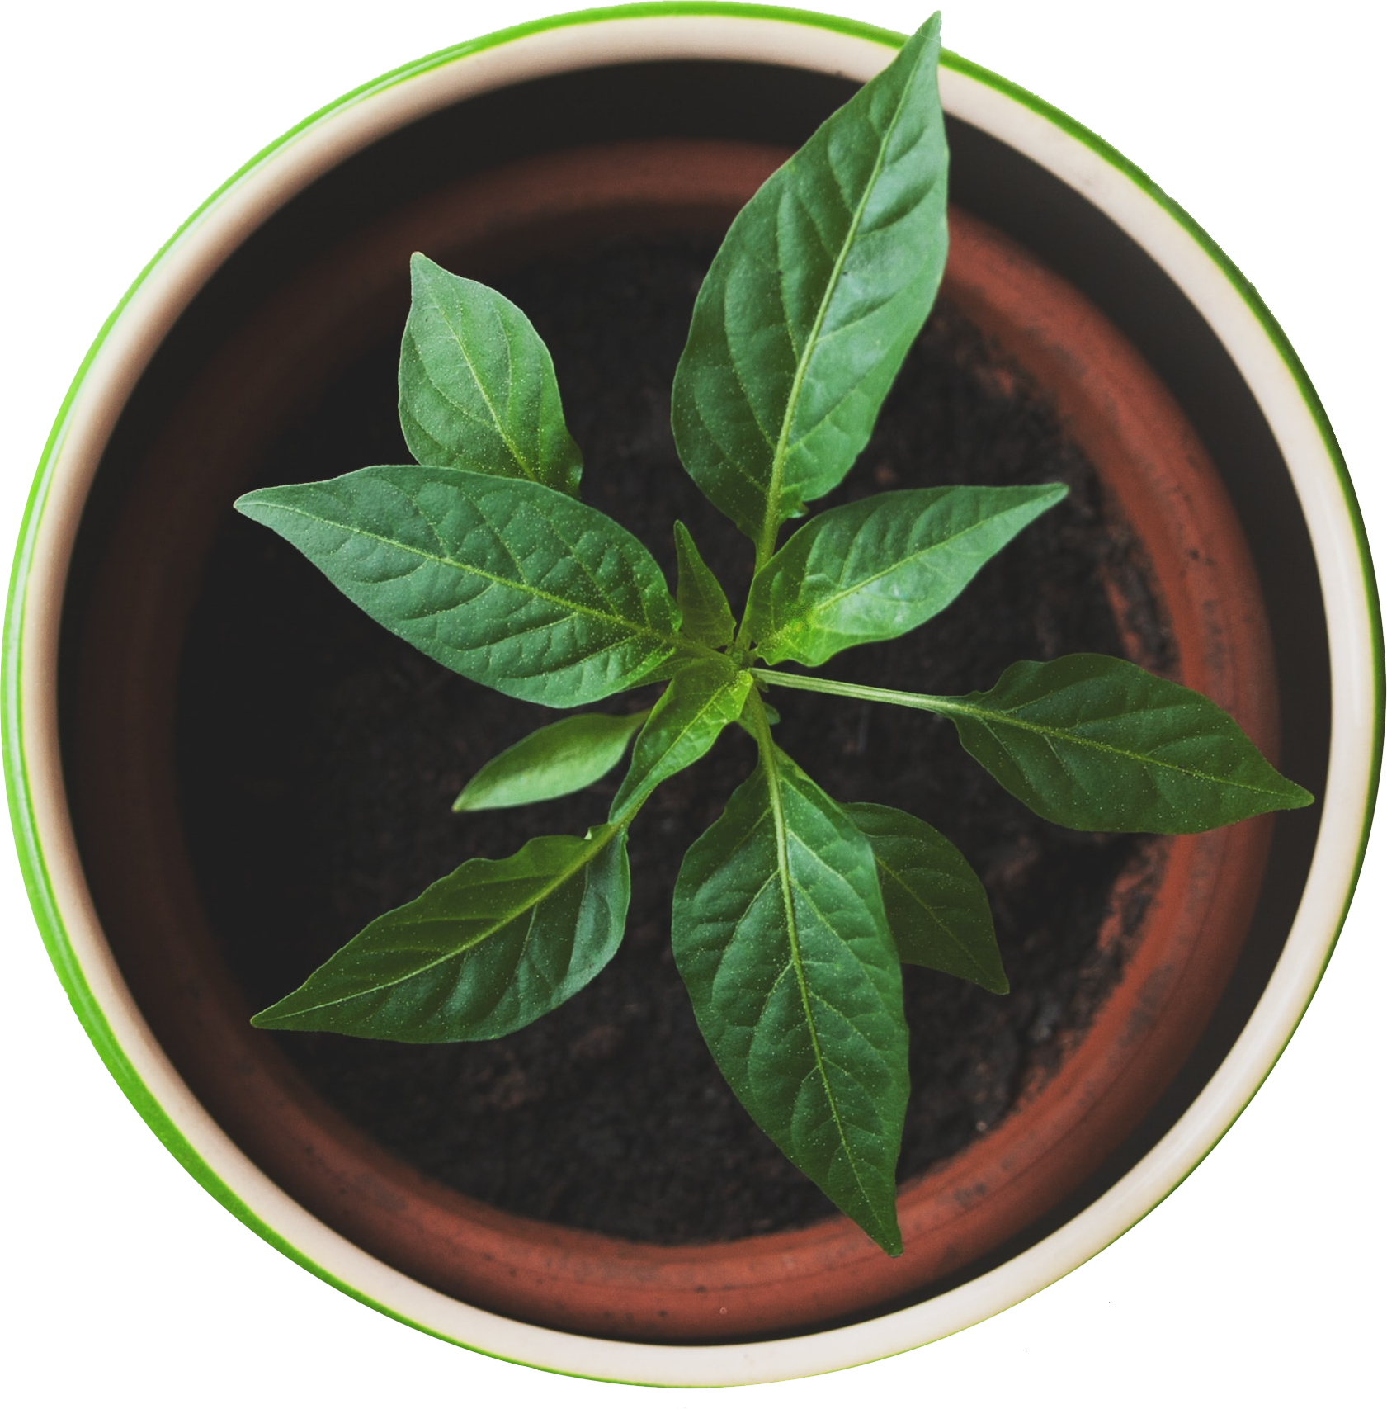

NURTURE
Noha Kareem
Anit Mariyam Aji
Nobuko Iki

Slide 2
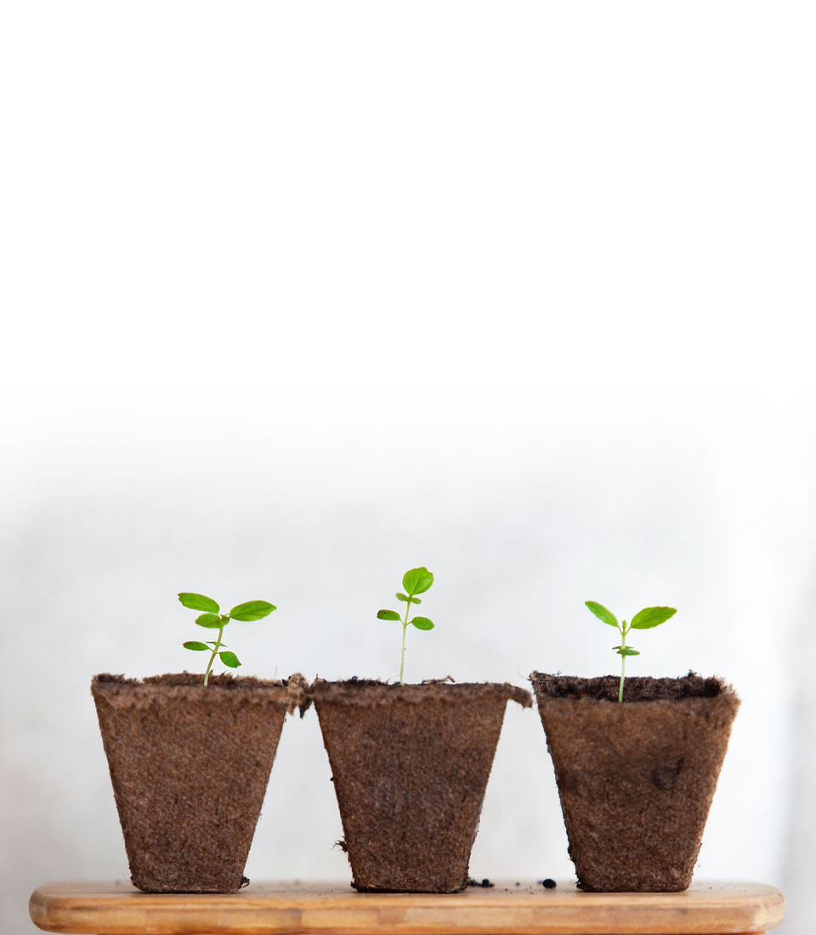
Did your plant wilt?
Having difficulties to take care of your plants?
Reviving the plants?

Slide 3
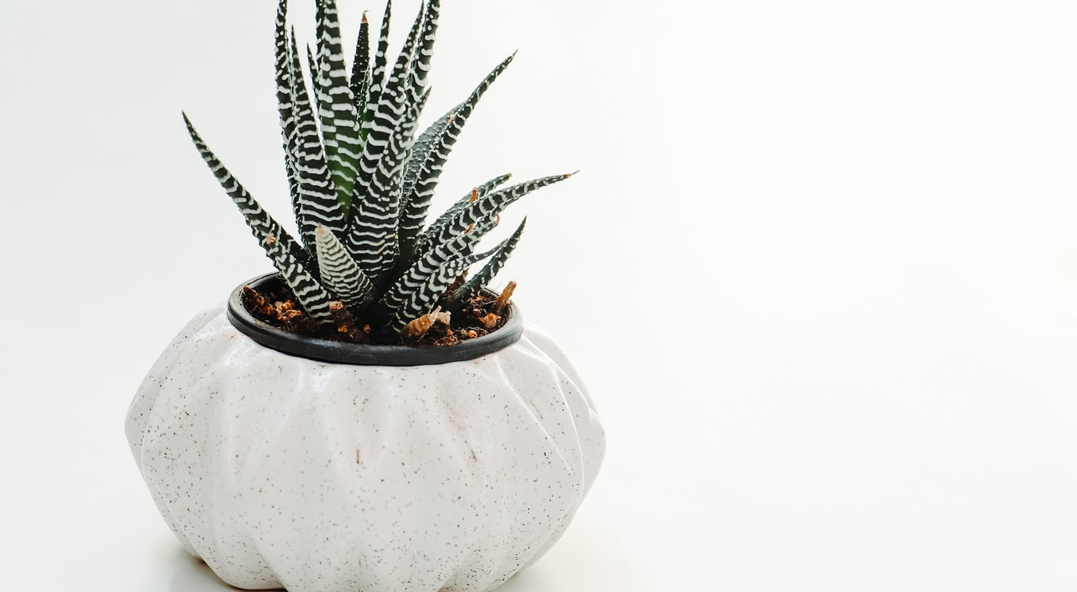
Plant Monitoring System
I wanted to introducing the system here…I don’t know if such a thing is appropriate here….
Like
Let us help you maintain your own planting journey
But I am not sure if I am making sense
Or I might sound weird…

Slide 4

Functionality
Moisture
Temperature
Light

Slide 5

Future plan
Register your plant from the plant library
From the plant library, you can access to the information on how to take care of your plant.

Slide 6
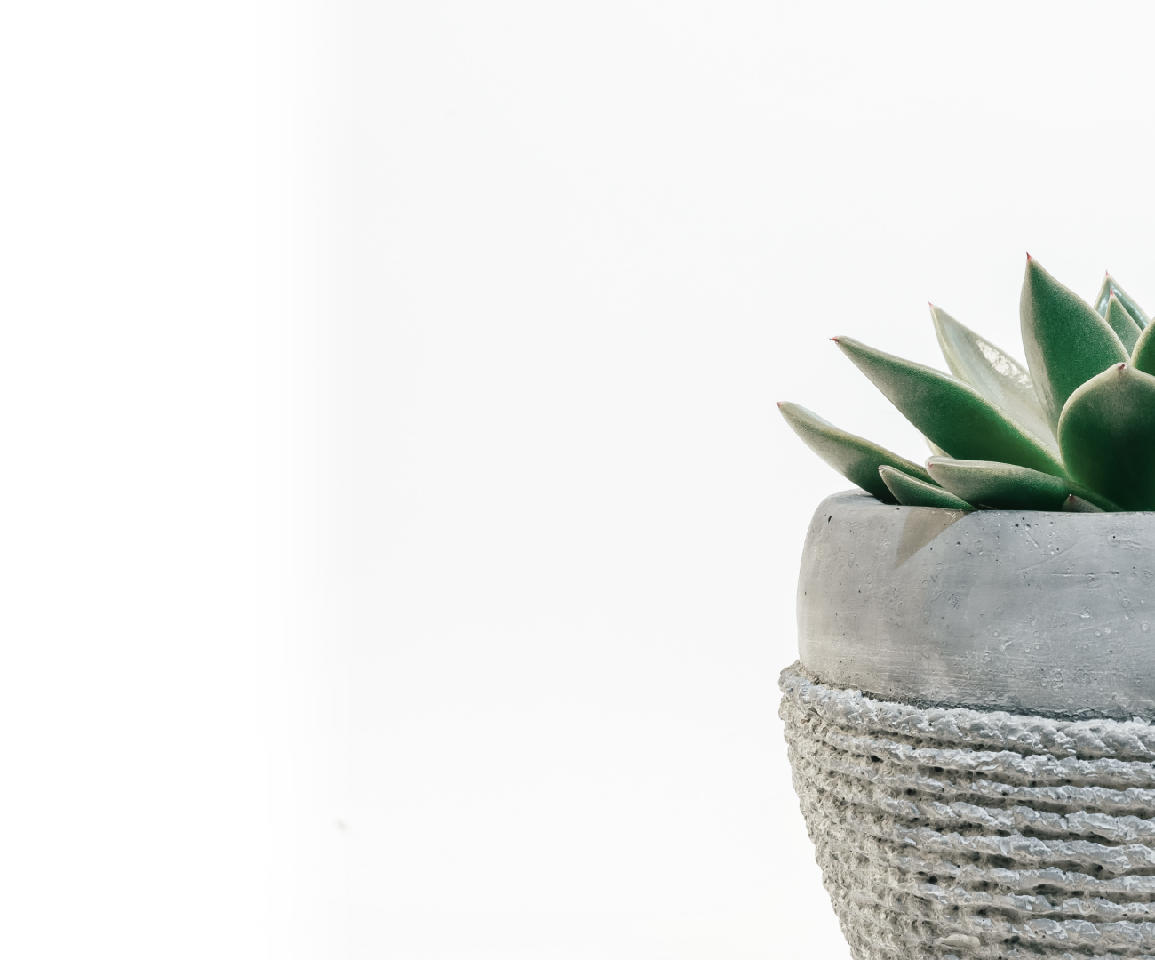
Something comes here
Explain NUTURE??? I don’ know… In the end???

Slide 7

Hope there are enough pages…
Than you

